Slide 1

DEPARTMENT OF COMPUTER SCIENCE AND ENGINEERING NOISE POLLUTION MONITORING
Team name : Proj_224788_team_3
TEAM MEMBERS:
JANANI.V.V (113321104031)
JAYAPREETHA.S (113321104033)
JAYASRI.M (113321104034)
KAMIREDDY CHARITHA (113321104035)

Slide 2
PROJECT
IoT (Internet of Things) noise pollution monitoring refers to the use of connected sensors and devices to collect data on environmental noise levels in various locations. This technology leverages the power of the internet and data analysis to continuously monitor, analyze, and report on noise pollution in real-time.
IoT noise pollution monitoring is a valuable tool for addressing the adverse effects of noise pollution in urban and industrial environments, ultimately working towards quieter, more livable communities.

Slide 3
PLATFORM REQUIRED
Noise Sensors:
High-quality noise sensors or microphones capable of capturing audio data.
Sensors should be durable and weather-resistant if deployed outdoors.
Low power consumption to maximize sensor lifetime.
Connectivity options such as Wi-Fi, cellular, or LoRa.
Data Acquisition and Processing:
Microcontrollers or single-board computers to collect data from sensors.
Signal processing algorithms to filter and preprocess noise data.
Secure data transmission to a central server or cloud platform.
Central Server or Cloud Platform:
Robust server infrastructure or cloud platform for data storage and analysis.
Data processing and analysis algorithms to convert raw noise data into meaningful information.
Real-time data handling capabilities to provide instant feedback.
Scalability to accommodate a growing number of sensors and data.

Slide 4
WEB DEVELOPMENT TECHNOLOGIES
Front-End Technologies:
HTML, CSS, and JavaScript: The fundamental building blocks of web development for creating the user interface and user experience.
Front-End Frameworks: Utilize frameworks like React, Angular, or Vue.js to streamline development, manage UI components, and provide a responsive, interactive interface.
Mapping and Visualization:
Leaflet or Google Maps API: Integrate maps to display sensor locations and noise data in a geographical context.
Data Visualization Libraries: Use libraries like D3.js or Chart.js for creating interactive charts and graphs to display noise data trends.
User Interface Design:
UI/UX Design Tools: Tools like Figma, Sketch, or Adobe XD can help design a visually appealing and user-friendly interface.

Slide 5
Back-End Technologies:
Server-Side Framework: Choose a suitable back-end framework such like Node.js (with Express), Ruby on Rails, Django, or Spring Boot to handle data processing, authentication, and API endpoints.
Databases: Select a database system for storing sensor data, user information, and configuration settings. Options include PostgreSQL, MySQL, or NoSQL databases like MongoDB.
API Development:
Develop RESTful or GraphSQL APIs to facilitate communication between the front-end and back-end. Use technologies like Express.js for Node.js or Django REST framework for Python.
Real-Time Capabilities:
Implement real-time features for live noise monitoring and instant alerts using WebSockets, or explore libraries like Socket.io.
Security:
Ensure data security through encryption (HTTPS), user authentication, and authorization mechanisms.
Input validation and protection against common web vulnerabilities (e.g., Cross-Site Scripting, SQL injection).
Cloud Services:
Host your application and data in cloud platforms like Amazon Web Services (AWS), Microsoft Azure, or Google Cloud Platform (GCP) for scalability and reliability.

Slide 6
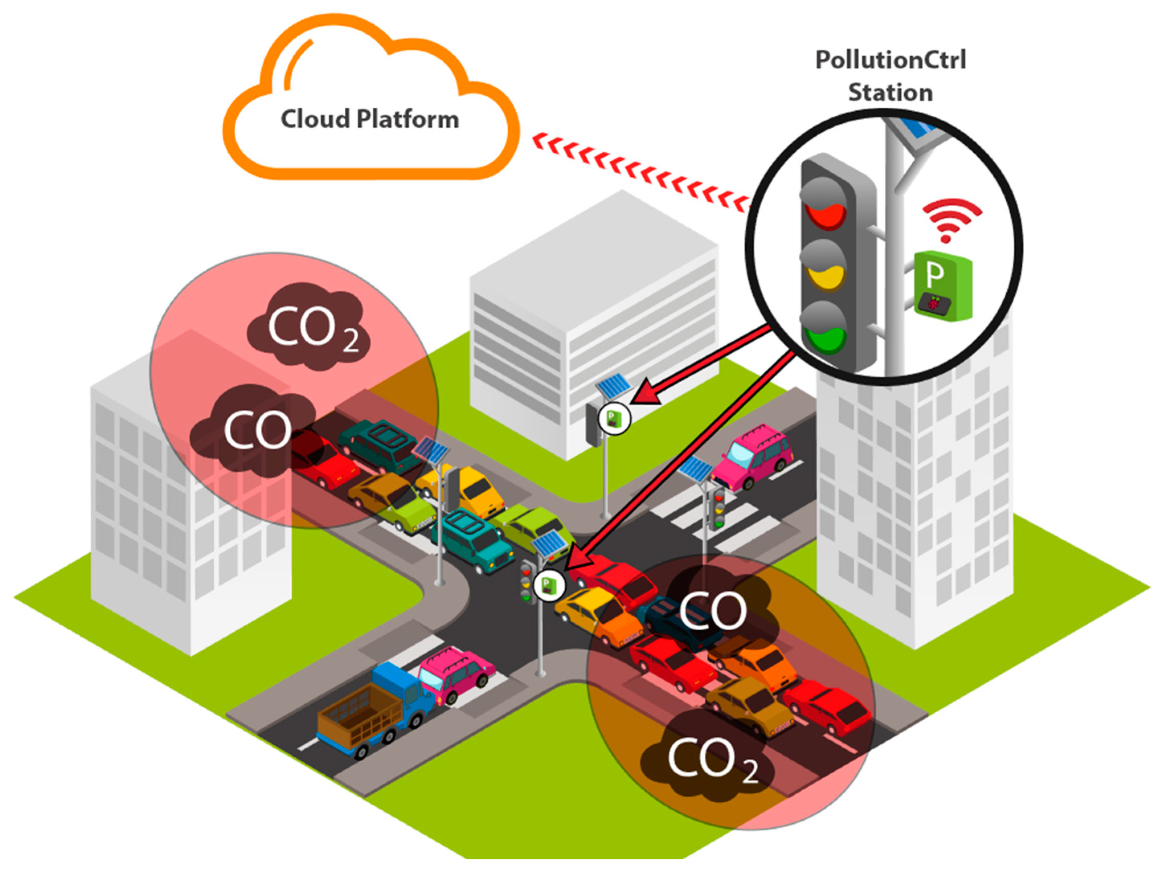
IOT SENSOR SETUP

Slide 7
CONCLUSION
In conclusion, noise pollution monitoring is a crucial component of urban and environmental management in our increasingly noisy world. The implementation of IoT-based noise pollution monitoring systems offers numerous benefits, including real-time data collection, data-driven decision-making, public awareness, and environmental impact assessment. These systems help identify sources of noise pollution, assess its impact on public health and the environment, and aid in the development of effective mitigation strategies and policies.
By deploying high-quality noise sensors, establishing robust data collection and processing infrastructure, and creating user-friendly web applications, noise pollution monitoring platforms empower communities and authorities to take proactive measures to reduce noise pollution and create quieter, more livable urban environments. Furthermore, as technology continues to advance, IoT noise pollution monitoring is likely to become an increasingly integral part of urban planning and environmental protection efforts, leading to healthier, more peaceful communities.

Slide 8
THANK YOU

